Slide 1
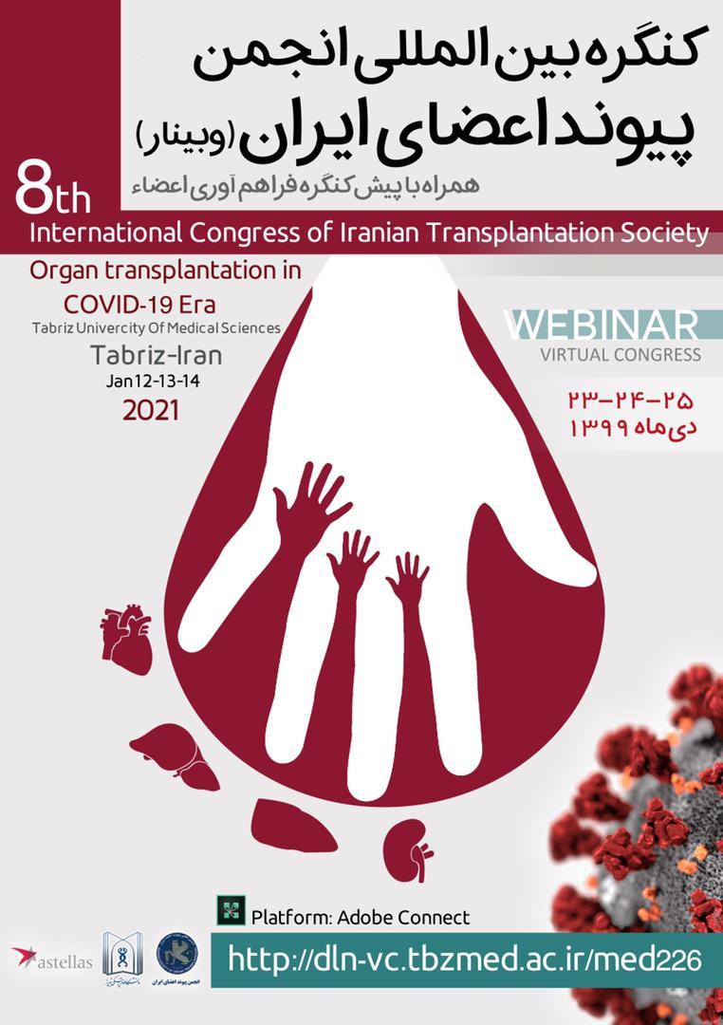
In the name of who
Life is from who

Slide 3
Kidney transplant in Tabriz medical science university
Afshar Zomorrodi
Professor of urology and kidney transplant surgeon
Head of urology department and organ transplant department

Slide 4
It is great pleasure and honor for me from 2standpoints:
1-to be host of a very distinguished scientist from Iran and oversea
2-to say welcome to distinguished doctors helping to human for saving lives of them
Welcome every body to 8th international organ transplant congress of Iranian society organ transplantation

Slide 5
The first kidney transplantation has been performed 37 years ago in 1986 by dr Tavagoli and late dr pourazand .

Slide 8
The second kidney transplant performed by dr simfrosh and late Dr bohluli, Dr nourizadeh, dr Zomorrodi in 1990

Slide 9
In 2016 in Tabriz medical science celebrated 1000th kidney transplant

Slide 10
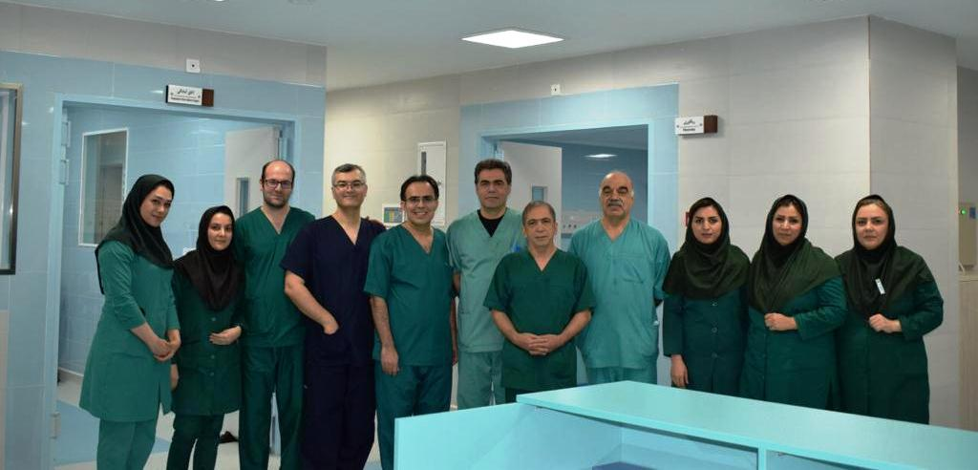

Slide 12
This center has four kidney transplant surgeons and two liver ransplants,8 nephrologists and two transplant hepatologist and 2 transplant cardiologist with three cardiac transplant surgeon
Organ transplant ward :32 beds
Theater room 4
Icu for cadaver

Slide 14
Thank you and hope have a nice meeting

